Slide 1
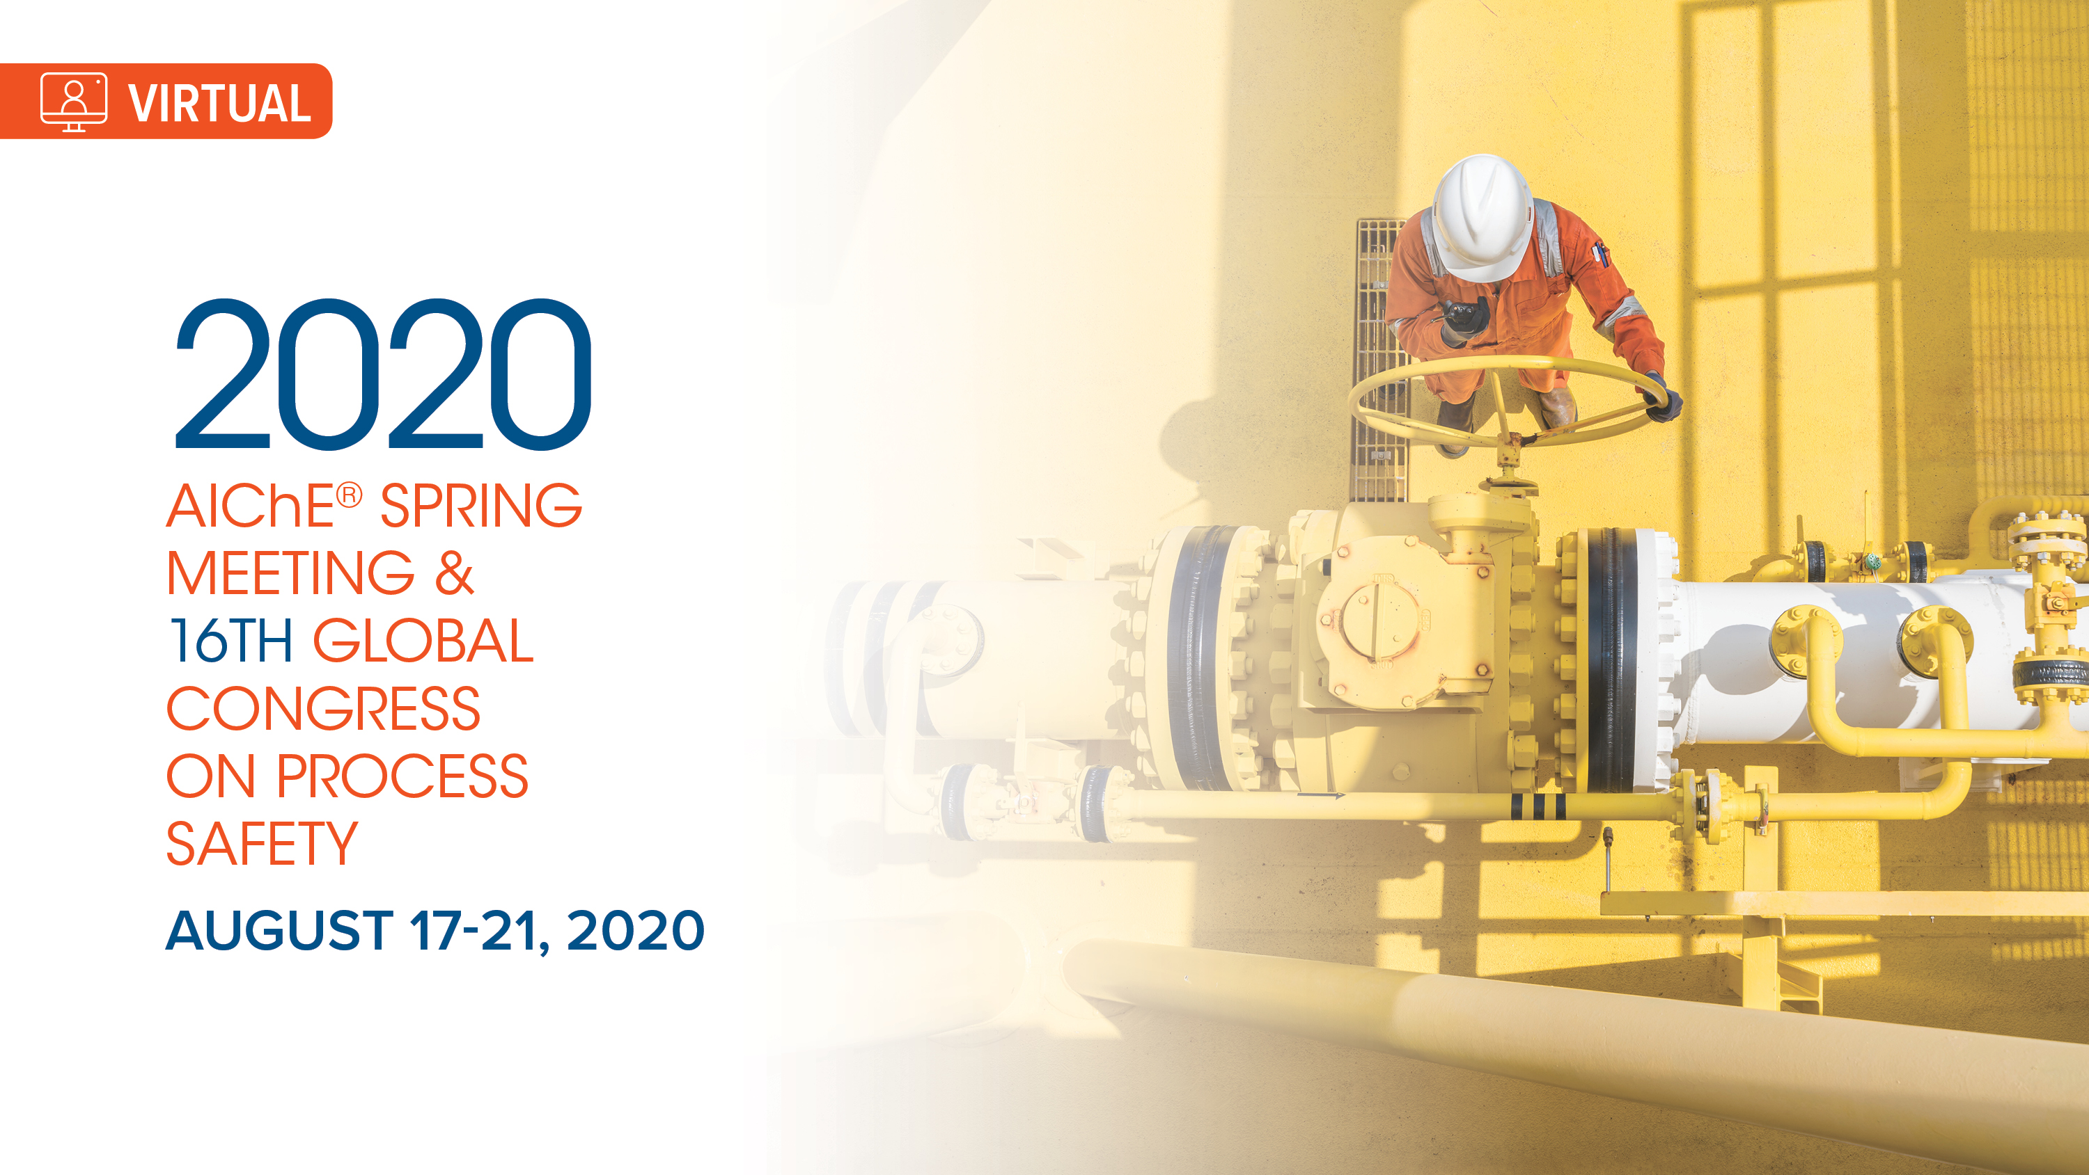
Engineering Career Development
William Docter, Ph.D.

Slide 2
Ice Breaker: Turn on Annotations and mark all applicable to you!
Pop Culture Familiarity
Star Trek
Jurassic Park
The Princess Bride
The Matrix
Ancient Aliens
ChE Experience (classwork, projects, coop…)
Flowsheet modeling (ASPEN,HYSYS, Pro-II…)
Working in Teams
Process Control
Real Time Optimization
Career Interest
Technical Management Grad School Law Medical Other

Slide 3
Topics
Who is Dr. Docter?
Technical Career Stages
Setting and Accomplishing Development Goals
Communication and Marketing
Mentoring Integration with Stage Development
Considerations for Grad School
Stress Management

Slide 4
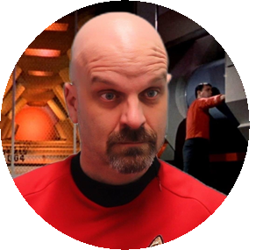
PERSONAL PROFILE
Bill Docter
Senior Real Time Optimization (RTO) Expert (= Process Control + Flowsheet Modelling + Economics + Automation)
EDUCATION
Ph.D. Chemical Engineering, Lehigh University, 1998
Chemical Process Modelling & Control Research Center
Model Order Reduction/Subspace Identification
B.S. Chemical Engineering, University of Cincinnati, 1993
WORK EXPERIENCE
27 years’ experience at ExxonMobil, ~75% in RTO Roles
<1 : Upstream RTO Project Lead (2025 to present)
16 : Beaumont Refinery/Chemicals
2 : Fawley (UK) Refinery
3 : Antwerp (BE) Refinery
6 : Research & Engineering
3 years’ internship experience at Quantum Chemical Allen Research Center,1989-93
Polyethylene Catalysis; Pneumatic Controls to PLC migration project
ACHIEVEMENTS (WHAT I AM MOST PROUD OF)
Patent on Hydrocarbon Processing Economic Analysis
Process Control Risk Assessment/Analysis Contributions to Process Safety
Operationalizing Fawley’s Diesel transition from 50ppm to 10ppm sulfur
Driving Beaumont DMC/RTO Value Capture >40MM$/yr for 3 straight years
Advocacy of STEM Mentoring both in-company and external
Redefining AE technical leadership Roles & Responsibilities with focus on Succession Planning

Slide 5
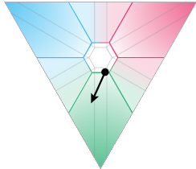
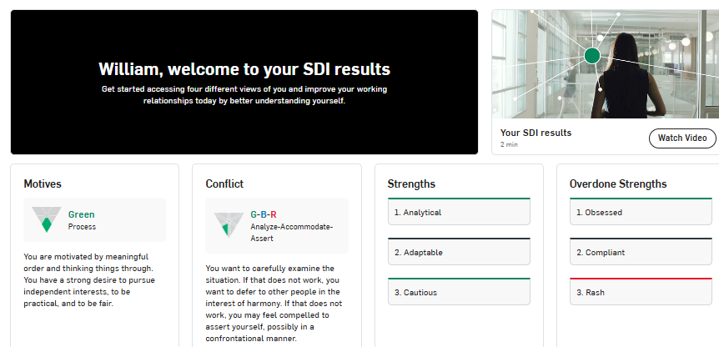

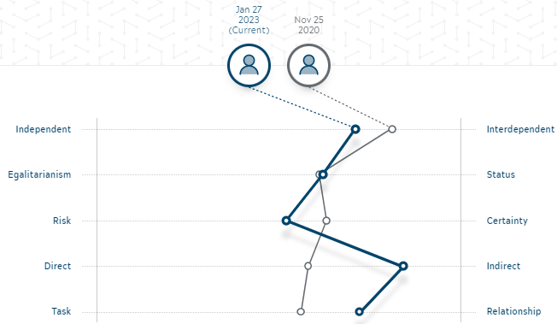
MBTI/KTI: INTx
Introvert / Extravert
INtuitive / Sensing
Thinking / Feeling
Judging / Perceiving (split)
Words to Live by
Know Thyself and Those Around You
Challenge your Preconceptions or they will Challenge You
HOBBIES
Video Games
Woodworking
STEM Outreach
Star Trek/Star Wars
Core Strengths Profile
People
Results
Goto/CSprofile
Process
PROFILE
Family
Married 27 years
2 Adult Children
Former
Youth Basketball Coach
Drama Club Carpenter
Sunday School Teacher
Suggested Reading
Keirsey, David, “Please Understand Me II”, Prometheus Nemesis Book Co., 1998.
Detailed work on the KTI (similar to MBTI)
Know your type, strengths and weaknesses, and how to approach style preferences of others
If the University or Your Employer offers similar tools, become familiar with them as part of your Interpersonal Development

Slide 6
Technical Career Stages

Slide 7
Technical Career Stages
Student
BS, MS, PhD
 | Stage | Focus | Work Scope
1 | Apprentice 1-2 yrs | Learning the Business | Training – Tools, Skills, Work Processes, Job Specific Theory Tasks within project (under direction of Stage 2-3)
2 | Colleague 5-10+ yrs | Implementing | Competent on standard Application and Troubleshooting in own discipline Leading and contributing to standard projects of predefined scope. Onboarding and training Stage 1
3 | Expert 10+ yrs | Leadership/Mentoring | Defining Projects and Initiatives (Scope, Benefit, Cost, Time) Advanced Application & Troubleshooting Leading New Technology Pilots & Commercialization Mentoring Stage 1-2 Coaching, 1-on-1s, Shadowing/Delegating Accountability on “Individual Development Plans”
4 | Sponsor | Strategic Vision Regional/Global Influence | Developing the Strategic Plan (1 & 5 year) Promoting the Strategic plan Driving Emerging Technologies to Commercialization Regional/Global Discipline Health
R&Rs with significant non-technical component

Slide 8
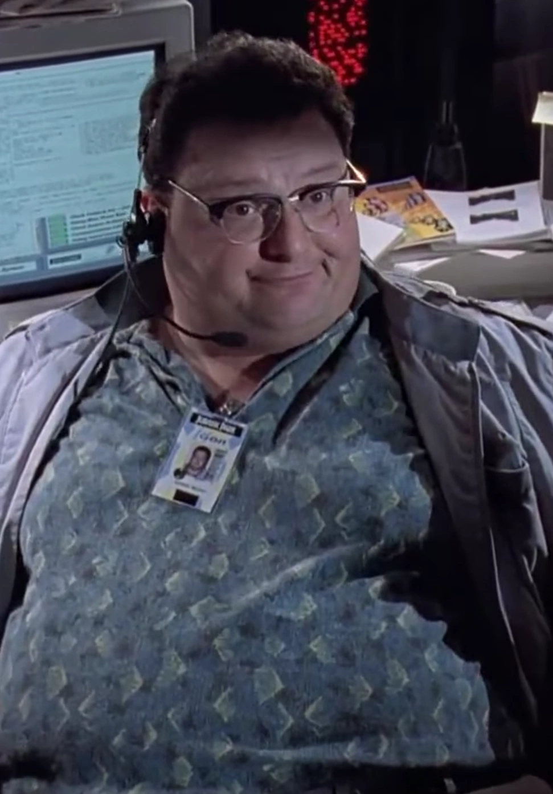
Being a Successful Expert is not all about the Technical Skill
Jurassic Park’s Nedry is classical example of a failed expert that does not realize that he is a failed expert
Very Experienced & Proficient in Technical Skills
Does not care about his team
Does not take ownership of mentoring
Does not take ownership of succession planning
In fact, adds barriers to it
Does not take ownership of Advocating Technology
Blames others for not understanding what he does
No Ethics – actively undermines employer / violates NDA / theft
It is every Senior Engineer’s responsibility
Be Ethical
Develop the Next Generation
Be an Ambassador for Technology

Slide 9
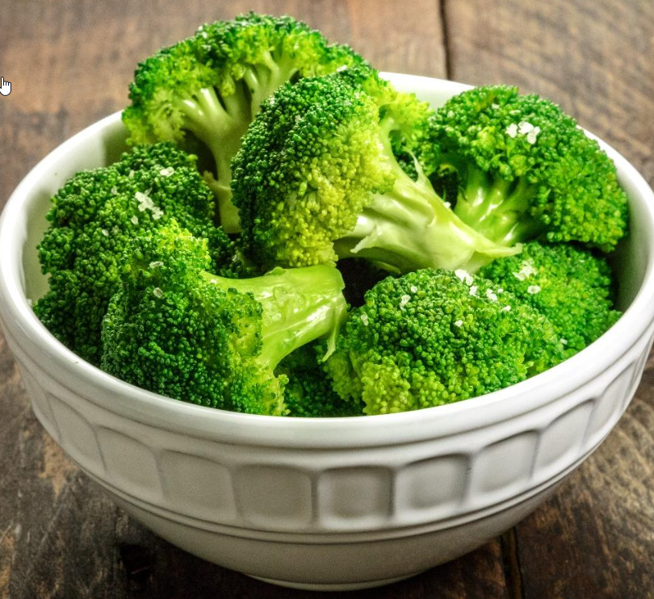
Roles Across Bill’s Technical Career Path
Offline RTO Development
FCC 1st Principles Modeling
Remote Support
RTO Site Lead
Crude, FCC, Reforming
Explainer Online Pilot
Applications Group Lead (=First Line Supervisor)
& Utilities Engineering Lead
Onsite FCC RTO Commissioning
RTO Site Lead
Crude, Diesel Desulfurization
Control Engineer Course Instructor, Explainer Innovator (Extended Reports)
RTO Site Lead
Hydrocracking & Olefins
COVID Work Processes
FCC RTO Project Lead
RTO Course Instructor
RTO Site Lead
Crude, FCC, Alky, Aromatics, Hydrocracker, Gas Plant
Principal Process Control Eng, Beaumont Area
Inflated Ego!
Apprentice
Colleague
Expert
Non-Technical Roles
Sponsor
1998
2004
2009
2017
2020
2023
Beaumont
EMTECH (VA)
(XOM Merger)
Fawley, UK
EMTECH (NJ)
Antwerp, BE
EMTECH/BMT

Slide 10
Before You Declare Yourself a Technical Expert…
Beware of Blind Spots -- “What You See Is All There Is”
You will eventually plateau in an assignment
Have learned all required to fulfill that assignment and practiced it enough that it has become routine
Doesn’t mean you have learned all that is required to fulfill any assignment
Plateaus should trigger a change in course of assignment
Plateaus and necessary course changes are often not visible to the individual
Efficiency & Capability
X
Plateau
Time

Slide 11
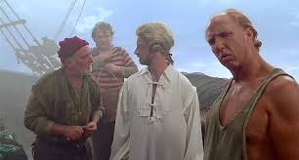
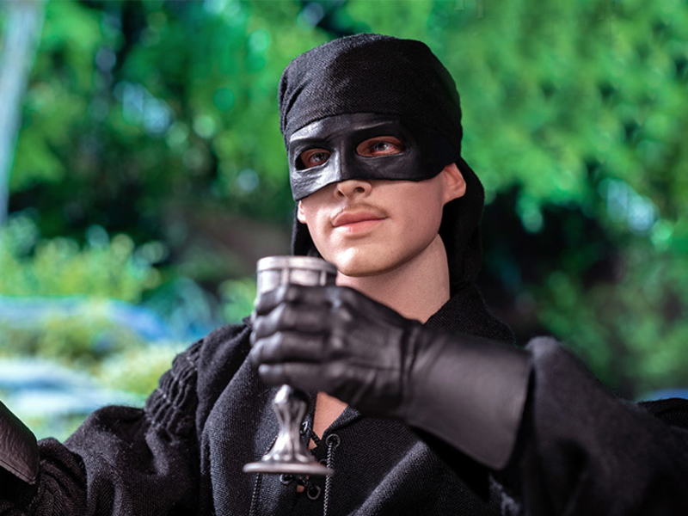
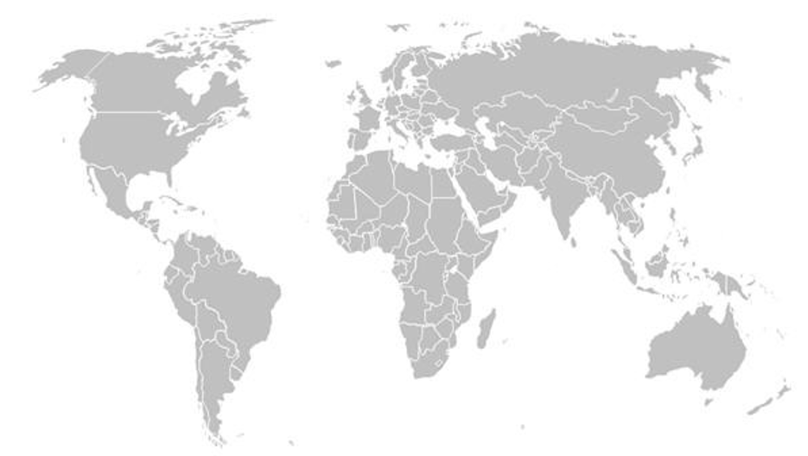
Relocations
Breakout of plateaus
Resets first impressions
Consider the story of the “Dread Pirate Roberts” from the movie “The Princess Bride”
Grows your network
Tags you Regional & Global
“Central Engineering” and “Manufacturing Site” Tags
X

Slide 12
Central Engineering vs Manufacturing Assignments
Central Engineering (LbIT) | Manufacturing Sites (LBIt)
Emerging tech more visible (T) | Business challenges more visible (B)
More access to tech area experts (IbT) - Network growth (Tb) | More access to operations experts (IBt) - Network Growth (tB)
Selling technology (IbT) | Buying technology (IBt)
More Business Travel (LTbI,life balance) | Less Business Travel (LtBI,life balance)
Mid level tech expert has regional/global line of sight can leverage knowledge across multiple site earlier in career (L) | Mid level tech expert can be big fish in small pond in focused areas - can/must lead local site initiatives earlier in career (L)
 | More access to the “car” (IT)
Consider taking assignments in both
Increases understanding of general interest
Connecting emerging tech with business
Both sides claim you as one of their own
Development Dimensions
L =Leadership
B =Business
I =Interpersonal
T =Technical

Slide 13
Setting and Accomplishing Development Goals

Slide 14
Dimensions Of Development and Mentoring Focus
Leadership
Commitment to Excellence
Owning your work
Business
How to get work done
Stewardship / Systems
Industry and Company Standards
Big Picture Understanding
Interpersonal
Working in Teams
Networking
Communicating to Stakeholders
Technical
Undergrad Engineers often focus exclusively on developing this dimension and underestimate the importance of the other three
Important, but needs to be balanced with development in other dimensions

Slide 15
Examples
Leadership
Mentoring/Tutoring
Undergrad Research Projects
Team lead in Extracurricular
Volunteer in Outreach, JA(Finance Park, JA-in-a-Day)
Business
Internships/Co-op
Researching Employers
Interviewing Workshops
Interpersonal
Mentoring/Tutoring
Group Projects
Team/Group Extracurricular Activities
Volunteer in Outreach
Technical
Mentoring/Tutoring
Technical Electives
Plenty of focus already in the base curriculum
Many activities have potential to develop more than one dimension at the same time

Slide 16
Crafting a Balanced Development Plan
Set at least one objective each planning cycle (~yearly) in each Dimension
Leadership
Business
Interpersonal
Technical
Focus on Quality over Quantity
Setting too many goals can often result in none of them getting done well and feeling overwhelmed (3-4 items at most in each area)
Tie each objective to a tangible deliverable that requires the competency
Training doesn’t stick or deliver value without practical reinforcement
Tie development accomplishments with value delivery in performance discussions
Identify & leverage a mentor strong in the competency
You can’t teach yourself if you don’t know what you don’t know
Discuss your development plan with your Mentor & Supervisor regularly
Get a Mentor’s input on your plan → Flush out your blind spots!

Slide 17
Communication & Marketing

Slide 18
Connections Matter - Start Building your Network Now
University Experience
-10
Undergrad
B.S. Chemical Engineering
Advanced coursework in optimization and process control
Informal research assistantship with one of faculty (AC)
Recommended I apply to Lehigh U for grad school
8x3mo Internships
Polymerization catalyst synthesis and testing
Lab/analytical technician
Control replacement project -- pneumatic regulatory system to PLC
Panelman on HDPE pilot reactor
Mentored by J.H. and S.L.
-5
Advisor: C. Georgakis
Research Funded by Exxon, Air Products, Praxair, & BOC.
Presented research progress to every 6 months
Exxon rep was one of my interviewers and became one of my mentors for next 10 years, taught BCET together.
Teaching Assistant for B. Luyben and W. Schiesser
my first refining supervisor’s son was in the class
Graduate School
3mo Internship @ Air Products
Worked in silo on technical. Dropped ball on building network
X
0
Exxon Research & Engineering

Slide 19
Pro-tips for landing an offer
Build and Leverage your network
Co-op/Intership is one of most effective tools
Establish relationships with folks who work in the field you are trying to get into
Grad students → get to know those funding your research
Be professional in your dealings with others
Anyone you interact with is a potential future employer
Don’t burn bridges
The world gets smaller as you get more experienced
Present, Present, Present
Remember Landing the job is the beginning of the interview
Over course of your career you will be evaluated many times

Slide 20
Get your brand off to the right start
Your boss will ask you to do tasks you don’t know how to do
You are new, so there will be a lot of things you don’t know, and your boss and team know that
You are expected to work with your team and leverage them
Leading with “don’t” and “can’t” excessively taints your brand
Seek guidance to extend yourself rather than Stating your gaps.
Consider your reaction to the two following people
Nat -- Intelligent, industrious, impulsive, critical, stubborn, envious
Pat -- Envious, stubborn, critical, impulsive, industrious, intelligent
First impressions carry more weight
Structure your messages to leverage the “halo effect”
Recognize when your judgment is also skewed by the halo effect

Slide 21
Reference point matters
Cup is half-full vs. half-empty
Driving incremental performance improvement
versus
Reducing past lost opportunities
Consider your words carefully
Good news can easily be made to sound bad
Objective is to frame a story so that it make you AND your team look good
Get someone to peer review your presentations

Slide 22
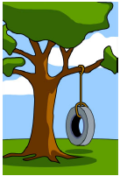

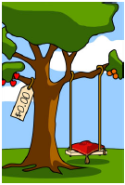
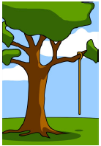
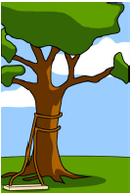
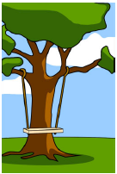
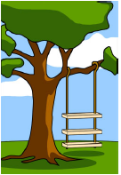
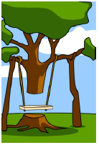
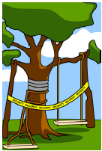
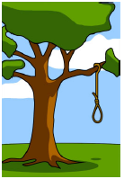

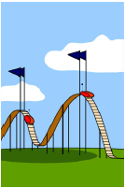
Communicating a Vision is Not Easy
What Group Lead Wanted
How it was pitched to Management
Scope Management Approved and Funded
What the Funding
Actually Allowed
Preliminary Engineering Design
Final Engineering Design
How the estimator bid it
How it was built
What Inspection Group Expected
How Risk Assessment Described it
How it was Documented
How it was Billed to the BTL

Slide 23






Where Programs of Change Fail
From Harvard Business Review January 2007, John Kotter
HBR publishes many great resources for coaching on soft skills !

Slide 24
No idea sells itself
Part of your job is advertising yourself, your team and your ideas
Target your audience
Part of an expert’s job is to translate their area in terms that non-experts can relate to
financial impact is almost universally understood by all stakeholders regardless of their tech background
Using pretentious language to make yourself sound superior or intellectually intimidate is rude and makes you look out-of-touch
Take the time to report your findings
Managers can suffer from WYSIATI and OOSOOM too
Highlight the value of your team’s work
Unless a value is stated, it is assumed to be 0 (WYSIATI)

Slide 25
Credit other contributors
Few things irritate folks more than someone taking credit for work done by other contributors
Human nature is to overestimate the importance of your own contributions and to underestimate those of other contributors
Others will want you on their team if you have a track record of making your team look good.

Slide 26
Mentoring Integration with Stage Development

Slide 27
Mentoring integral to Career Stage Model
Transition from one stage to the next only happens if developmental experiences, assignments, and mentoring position individual for the next stage
Corporate Succession Planning depends on Strong Mentoring Culture to Institutionalize Knowledge and Skills
Continuous Development is an Expectation in all Career Stages
Mentoring Competency importance increases as Organizational Reach builds across career
Regional/Global Business Owners
Central Engineering
Leads
Sponsor
Expert
Colleague
Other Discipline Sponsors
Other Discipline Experts
Apprentice
Other Discipline Colleagues

Slide 28
Mentoring Integration Across My Career
-1993 U. Cincinnati
-1998 Lehigh U.
Quantum Chem. Intern
Air Products Intern
Student (mult), Tutor (Calculus, Prob & Stat)(mult)
Research in Process Modelling and Optimization (mentored by CG, AC, AC2, JF)
Internships (Catalyst Research & Dynamic Simulation)(mentored by JH,SL,DV,JM)
TKD Student (HKK,mult), Assistant Instructor (mult)
Stage 1 Apprentice
1998-2001
Research & Engineering
Florham Park, NJ
Fundamental modeling upgrade project (mentored by MH, MA, HW)
RTO modeling & Remote Support (mentored by MA and BS)
Supporting sites in North America and Europe (mult)
Stage 2
Competent
Contributor
2001-2004 Research & Engineering
Fairfax, VA
RTO deployment and commissioning team member (JC, AC2, PH, & BB)
Sites in North America, Europe, and Asia Pacific
Mentoring site personnel on RTO (TT,VN)
Assisted on several R&D projects including “sliced bread” with JD
RTO basic course instructor/developer (with JC)
2004-2006 Antwerp Refinery
On-site RTO support (LB, HT, HL)
Lead RTO deployment at site (mentored by H.F.)
Extended technology to meet special business objectives
Extended “sliced bread” to high value prototype (with JD)
Regional process control network representative for Plant #1 (AC2)
Rolled out “sliced bread” globally the following year (JD,MW)
Receiving Mentoring
Stage 3
Expert
Mentor
Lead RTO projects in a few major refinery areas (mentored by BS, HW)
Extended technology, R&D, recognized globally (JD, mult)
DMC plant testing (mentored by SW, MS, and GT)
Basic Controls Engineer Training instructor (mentored by AC2)
Regional network representative / presenter (mult)
Trained up a new RTO Engineer (GT)
Providing Mentoring
2006-2009
Fawley Refinery
Lead RTO projects in several major refinery unit areas (PH, MM, BK)
Extended technology, R&D (RW, RR, HW, JR, AC2, JD)
DMC modeling and tuning (BS, RR)
RTO advanced course instructor/developer (mult)
Assigned to onboard and mentor new engineers (AC2,KW, AW)
Guest Lecturer to Lamar University Dept. of Chemical Engineering (mult)
Cold eyes review team leader at other manufacturing locations (mult)
Regional network representative / presenter / team lead (mult)
Best Practice Author (multiple areas) (mult)
Representing Site to Senior Management (mentored by CW, RV)
Became Applications Group Lead (mentored by DS,SK,MG, DD)
Mentoring team members and interfaces with business (mult)
Mentoring next Technical Group Leads in succession plan (mult)
2009-Present Beaumont Complex
Stage 3.5
Strategic Direction
Expert / Mentor

Slide 29
Technical Career Path, Stage 3+
 | Location | Role
2023+ | Beaumont Complex | Principal Process Control Engineer, Beaumont Area
2020-2022 | “ | Site RTO Lead (+Olefins, +Hydrocracking)
2017-2020 | “ | Process Control Group Lead (~First Line Supervisor, FLS) Utilities Engineering Lead
2009-2017 | “ | Site RTO Lead (+Sat Gas Plants)
Stage 3+ is more about people development and planning/driving strategic vision
Some assignments focus on building competency on those skills (FLS, Unit Engineering Lead, Principal Engineer)
Even on return to subject matter expert role, the R&Rs will skew toward people development & strategic > individual technical contributor
 | Stage | Focus | Work Scope
3 | Expert 10+ yrs | Leadership/Mentoring | Defining Projects and Initiatives (Scope, Benefit, Cost, Time) Advanced Application & Troubleshooting Leading Novel use of Technology – Pilots Mentoring Stage 1-2 Coaching, 1-on-1s, Shadowing/Delegating Responsible/Accountabe on “Individual Development Plans” of others
4 | Sponsor | Strategic Vision Regional/Global Influence | Developing the Strategic Plan (1 & 5 year) Promoting the Strategic plan Driving Emerging Technologies to Commercialization Regional/Global Discipline Health/Succession Plan

Slide 30
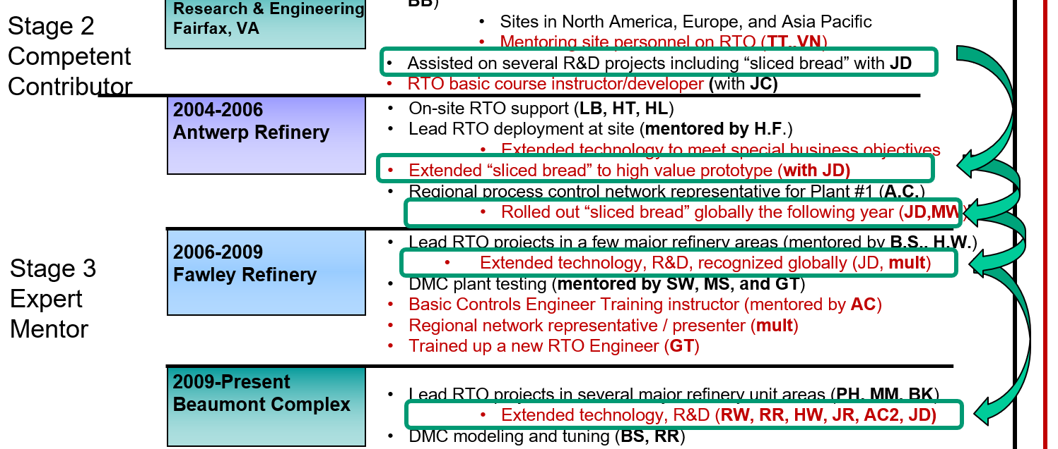
“Sliced Bread”
Mentoring relationships benefit both the Mentees and the Mentors.
JD mentored BD (Bill Docter) on “Sliced Bread Technology” during BD’s Central Engineering Assignment (EMRE)
JD was having difficulty getting business owner interest. Value delivery potential not clear or quantified
BD was new engineer assigned to work on Sliced Bread tool code and testing. No clear end user need & use case
BD took manufacturing assignment at Antwerp
End user need became visible. Other mentors at site provided work process guidance and helped quantify potential business value. (Others → BD → JD)
BD in position to be Site Champion for Pilot. Access to local resources to implement pilot, and access to JD for tech expertise.
JD/BD present pilot value delivery results to tech community and management. Tech Leadership push for global rollout
BD & JD continue Collaboration for Years
Mentoring rest of Global Community
Refinement of Technology and Integration into Work Processes

Slide 31
Building Strong Mentor Culture & Network
In early career, mentors may be assigned by management
They are held accountable to onboard you as a new employee
As your career progresses you need to proactively seek mentors
Identify who knows their stuff, build a strong relationship, and collaborate with them throughout your career
Pay it Forward
Others will invest in you if you invest in others
It is never too early to start
High school and college students are capable of tutoring other students in academics, extracurriculars, & outreach
Mentoring Proficiency builds with Practice

Slide 32
Avoiding “What You See is All There Is”
You can’t teach yourself if you don’t know what you don’t know
Locate yourself where the action is
Sitting by yourself in a closed office makes it difficult to leverage more experience team members.
Introverts will need to balance their preference to work alone
Other team members can suffer from out-of-sight out-of-mind (OOSOOM).
If you are present and something interesting comes up, you’ll get included.

Slide 33
GRad School Anyone ?

Slide 34
Grad School Tips
Commit to a doctoral program from the start
Easier to get funding if committed to a doctoral program than it is to get funding for a master’s.
Know who funds your professor’s research
Contributors will be most likely employment prospects
Talk/present to them every chance you get
Recognize the universal skills that graduate work develops
Innovation
Communication skills
“Publish or Perish”, “Present or Perish”, Marketing
Analytical skills
It is a myth that a doctoral degree pigeon-holes your career
Demand for data analytic skills is increasing across all levels of research and manufacturing. Increasing trend of Ph.D. now located at manufacturing sites

Slide 35
Stress Management

Slide 36
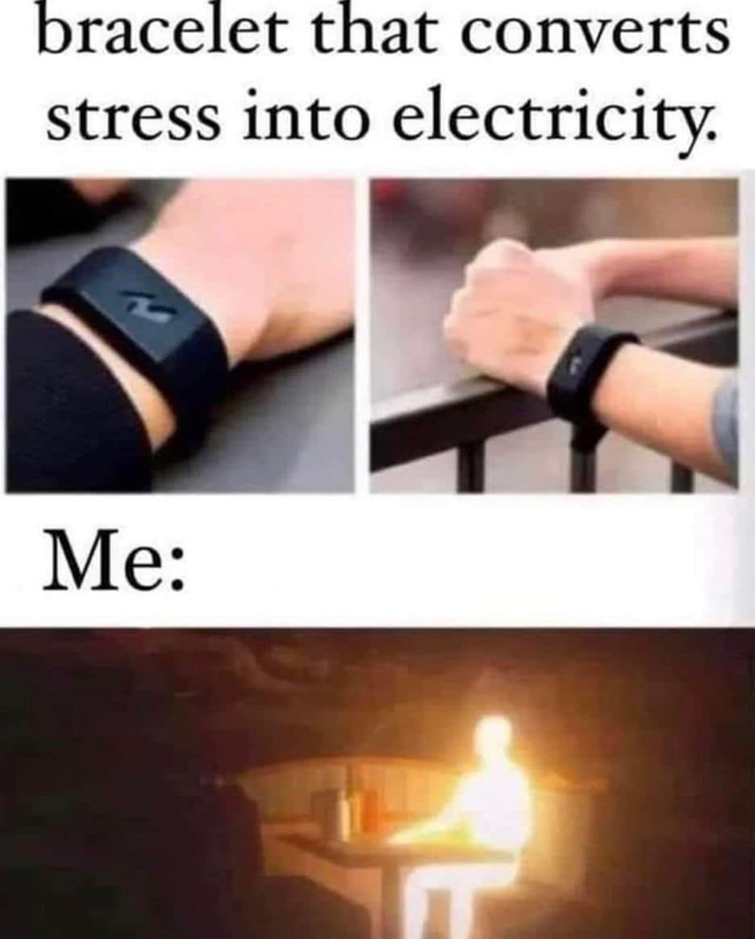
What I was like before I learned Resilience
Bracelet that converts
Stress to Electricity
Stress Management is a large component of “Resilience”, and something that I struggled with greatly in early in my career.
During my first coop job in 1990, I collapsed at work from an anxiety attack. My boss told me I needed to calm down or I was going to have a heart attack before I was 30.
With coaching and practice, I landed on coping strategies that worked for me, and I have not had health related issues since I finished grad school in 1998.
I still feel the pull toward the dark side, and it is with discipline of leveraging the learned strategies that I keep things in balance.
Me,1990 & 97-98

Slide 37
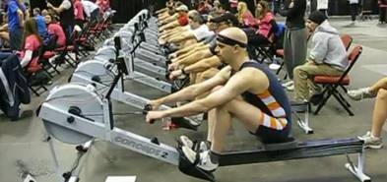
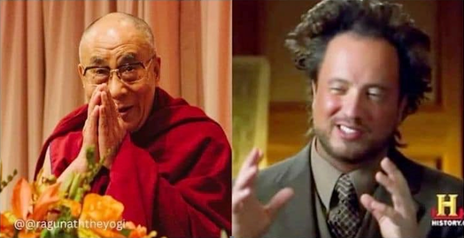
Exercise and Meditation
What I think I sound like on this topic
What I look like to others on this topic
Both exercise and meditation work by forcing one to let go of day-to-day stress items stuck in short term memory by pushing them out with non-stress items
Short term memory is limited to juggling <7 things simultaneously
Exercise has additional physical health benefits, but not accessible every minute
Meditation can be done anywhere and does not need to take long

Slide 38
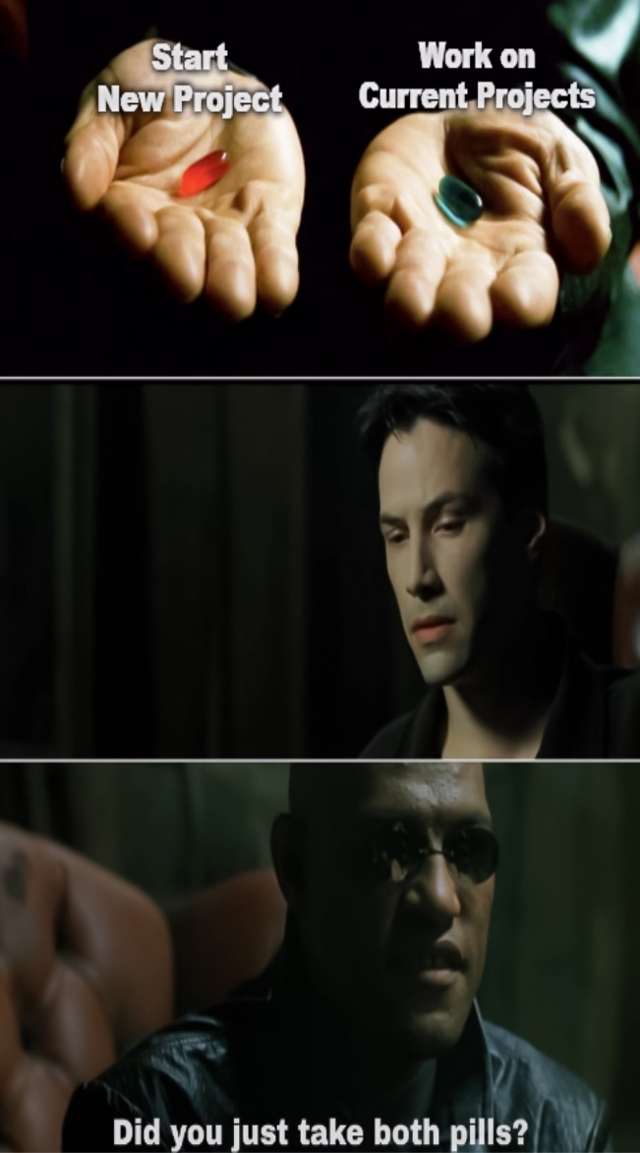
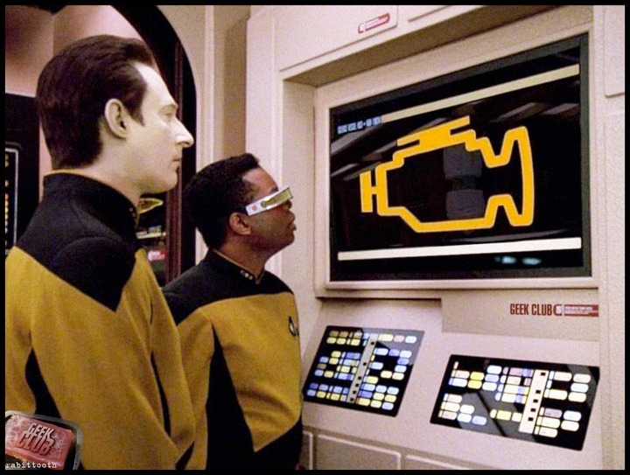
Work Management and Prioritization
Be realistic about what can be accomplished and what is above/below the line in tactical plan
Under-promise, Over-deliver
Knowing when to say “No” is the balancing of courage of conviction and making sound business decisions
Project manpower days does not equal calendar days
Assume reasonable day-to-day break-in rate in timelines
On mature technologies, there are rules of thumb for base sustainment. 0.2 FTE per DMC, 0.25 FTE per RTO, etc… Once base is set, the remainder is what is left for new initiatives
Day-to-Day Happens

Slide 39
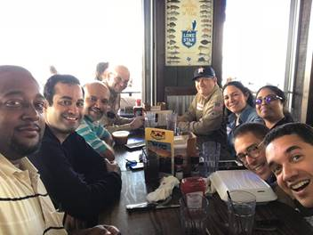
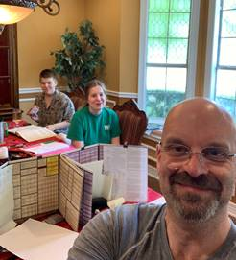
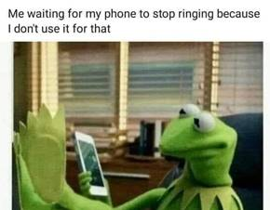
Downtime
Recreation
Work-life balance is critical for maintaining peak performance and being recharged to hit the next day running.
Fun time with friends and family
Hobbies
Vacation
Vacation
Truly getting away from work to recharge batteries fully
It is vital to have down time for peak performance. If you are still on call, checking emails, and attending meetings on vacation, it is NOT a vacation
From corporate point of view, Vacation is a part of our compensation package meant to retain employees and reduce burnout related job performance drops
Your vacation is an opportunity for the backfill to develop. If there are no backfills capable of handling the assignment, it is a succession plan vulnerability that needs to be addressed by line management.

Slide 40
WRAPUP

Slide 41
Summary
Technical Career Stages
Apprentice → Colleague → Expert → Sponsor
Career Growth through Stages Rely on Experiences & Mentoring
Mentors provide guidance coaching in Development Plan process, and assist navigating the Blind Spots
Individual must take ownership of Setting and Accomplishing Development Goals and building their Support Network.
Communication and Networking are key enablers for driving technical progress and innovation. Ideas do not sell themselves regardless of their value potential.

Slide 42
Dr.Dr’s Suggested Reading
Keirsey, David, “Please Understand Me II”, Prometheus Nemesis Book Co., 1998.
Detailed work on the KTI (similar to MBTI)
Know your type, strengths and weaknesses, and how to approach style preferences of others.
Kahneman, Daniel, “Thinking, Fast & Slow”, 2011.
WYSIATI, cognitive biases, framing choices, prospect theory, halo effect
Kotter, John, “Leading Change”, Harvard Business Review, Jan 2007
Newport, Cal, “A World Without Email”,2021
Time spent on email has to be managed and balanced. Can spend 100% of your day on just email without generating value.
Email is used for many things that are more effectively done on other tools, such as task boards (Dr.Dr. is a GitHub Project Boards fan since RTO application work has many similarities to software engineering)

Slide 43
Dr.Dr’s Tips and Tricks to Expert Development
Do your best in your current role
Enhance your team’s value if you expect others to want you on their teams
Approach tough assignments with a “can do” attitude
Can’t become an expert or gain reputation by doing only easy problems
If you don’t have all of the skills, leverage mentors and literature to acquire them
When asked if you would be willing to do a tough assignment, recognize the question itself is a test.
Present every chance you get
Recognize part of the job is sales of ideas and yourself
Your next presentation could be setup for your next assignment
Be active in network meetings for your technology area
Keep the learning curve steep
Creating an expert requires diverse work experiences
Even within a single tech area there are many
possible work experiences
Set Balanced Developmental Goals
Seek mentor’s guidance on goals
Monitor your progress
Grow your mentor network
Experts are forged, not born.
Identify who knows their stuff and leverage them throughout your career.
X

Slide 44
Thank YOU !

Slide 45
Abstract
In multigenerational industries, institutionalizing learnings and developing the next-up technology leaders and experts are key to continued corporate stability and growth. Succession planning and mentoring are needed across all career stages for employees to reach their full value delivery capability, regardless of whether the path pursued is technical or managerial. Likewise, leveraging one’s own capabilities to the fullest requires leveraging those capabilities through others, making steady development of mentoring competency a priority during all career stages. This presentation will cover Bill Docter’s career track at ExxonMobil, how mentoring has been integrated throughout his career, and driving group mentoring culture as a senior technical lead in process control and optimization.

